Slide 1
The Turtlebot Project
Sensor group

Slide 2
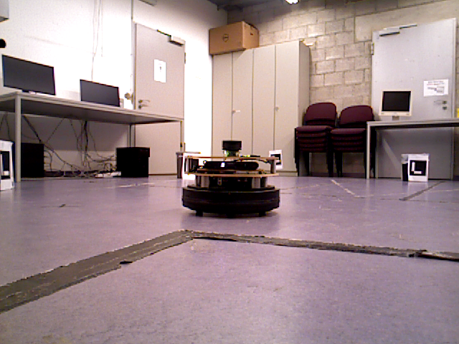
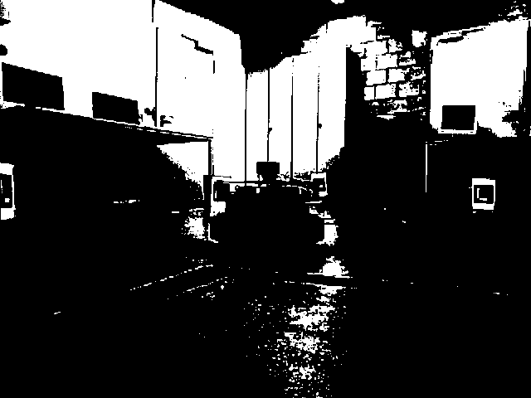
Binarization
Double fixed threshold or K-Means

Slide 3
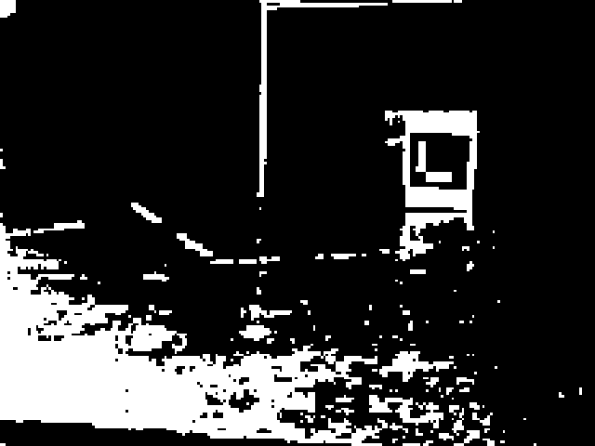
Zoom
Subdivision in 4 or 9 parts
Bilinear or bicubic resize
Allows greater detection distance

Slide 4
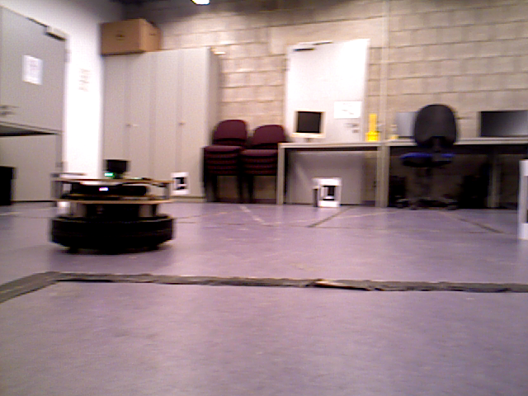
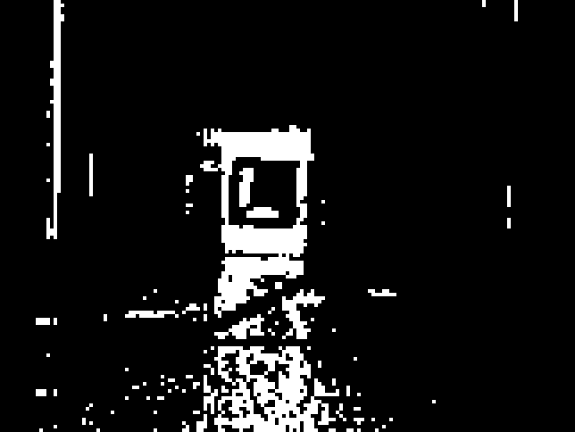
Deblurring
Lucy-Richardson algorithm
Allows better recognition when rotating

Slide 5
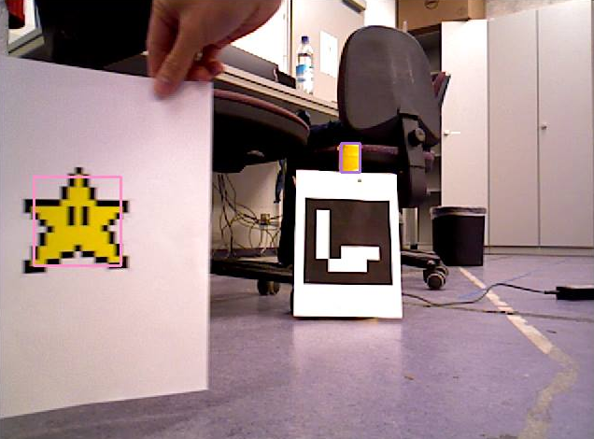
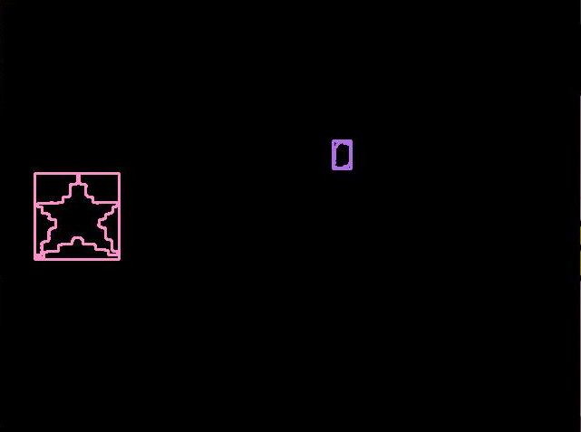
Friend detection
Color recognition in CIELab color space

Slide 6
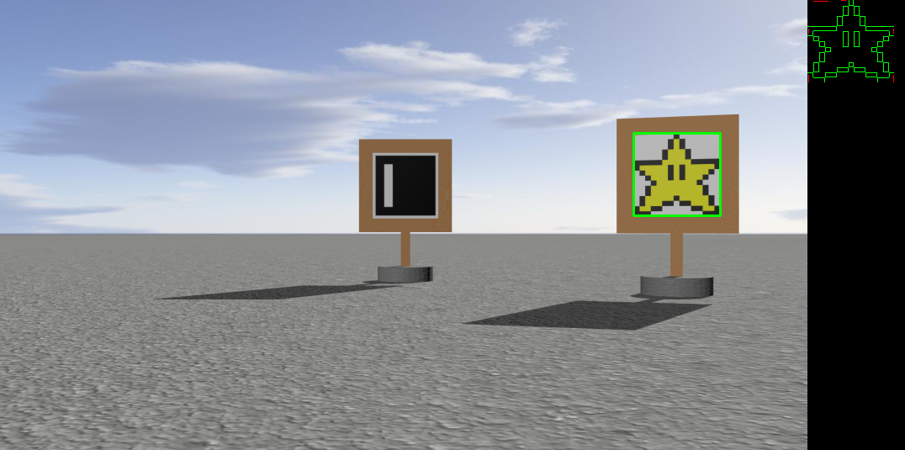
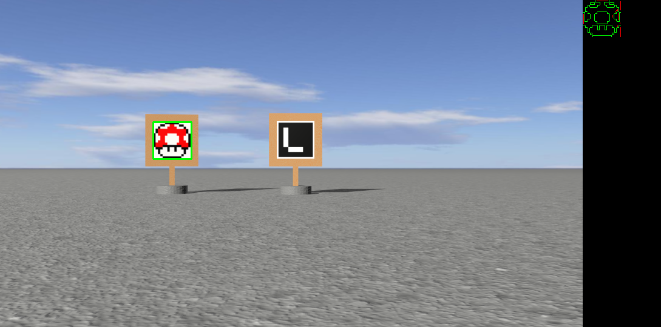
Friend detection
Shape comparison with Laplacian or Log filter and morphological transforms
Independent from distance

Slide 7
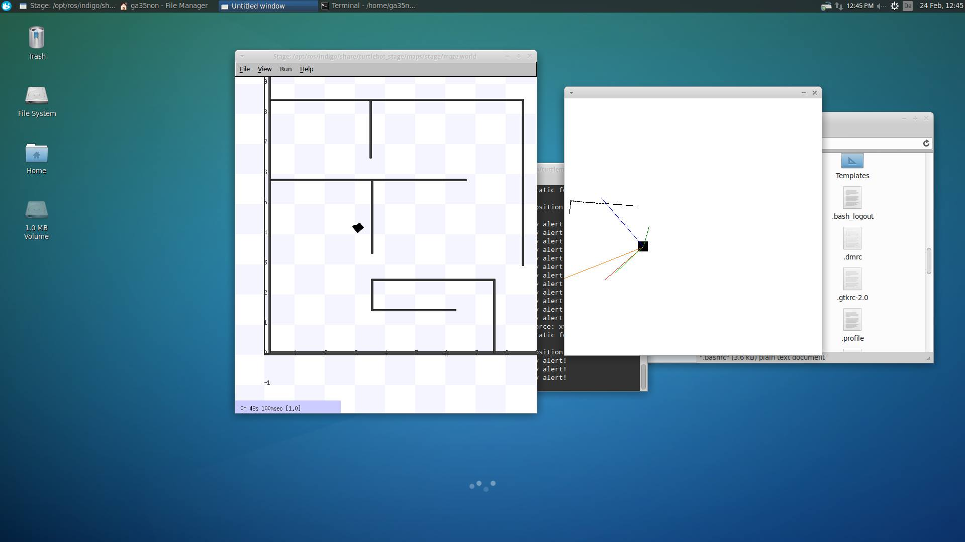
Dead reckoning
Self-localization based on motion sensors, wheel sensors and movement equations

Slide 8
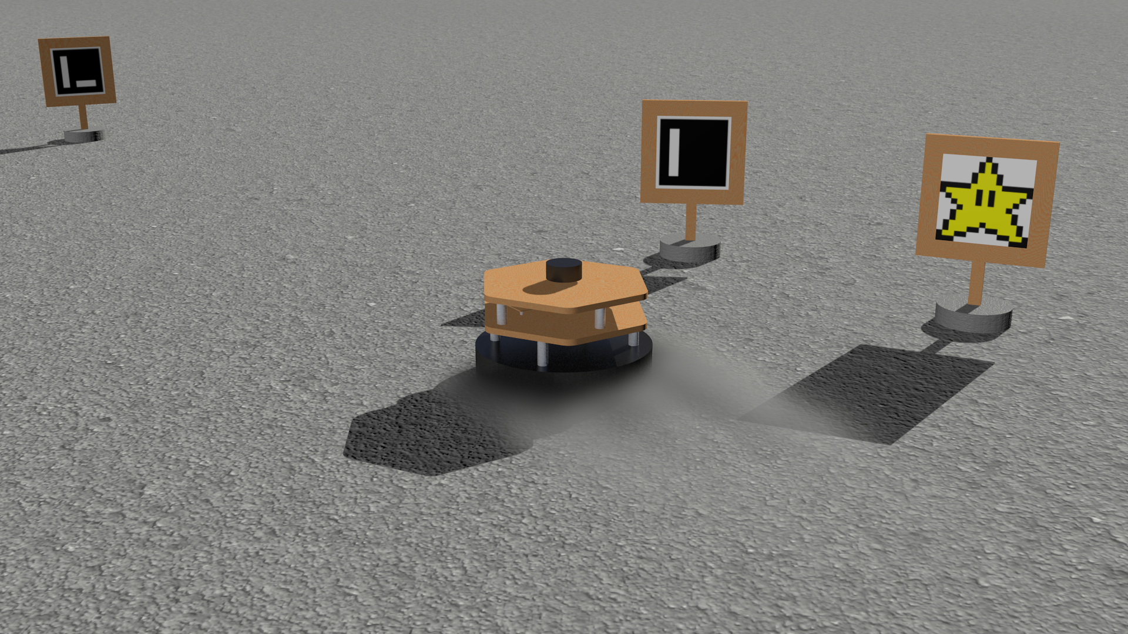
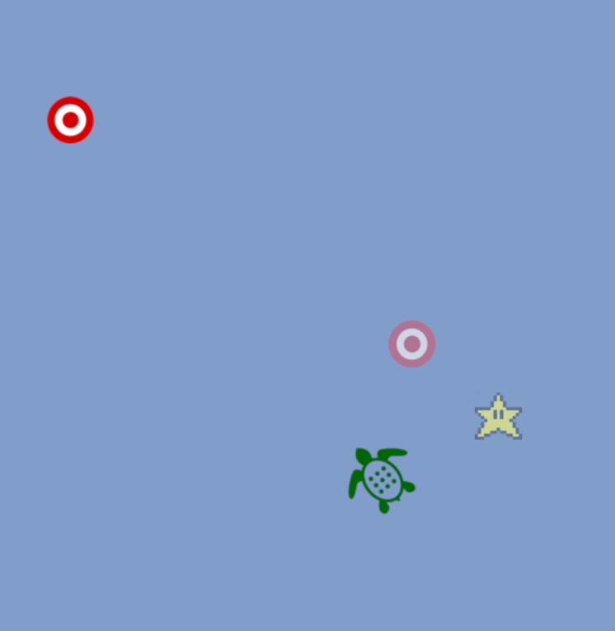
Map
2D positioning of objects in real-time
Based on camera view with perspective computations

Slide 9
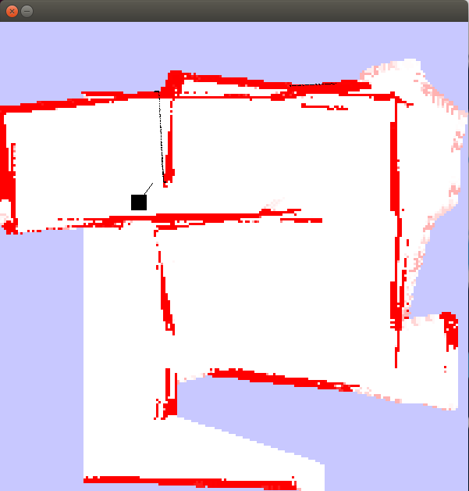
Obstacles localization
Static probabilistic map of obstacles in real-time

